Slide 1
Extracting data
KC4000 relational databases

Slide 2
Recap on terminology
Database – collection of persistent and structured data
DBMS – a database management system is a software tool that manages the database
Database system – Database + DMBS

Slide 3
Extracting data - sql
SQL is the basis of all database programming
As a language, SQL is:
Non-procedural
Specify the target, not the mechanism (what not how)
No loops or tests for end of file
Safe
Negations are limited by context
Set-oriented
All operations are on entire sets [tables]
The operation is automatically applied to all rows in a table
Relationally complete
Has the power of the relational algebra
Can use restrict operation clauses
Functionally incomplete
Does not have the power of a programming language like Java
This is not a big deal if we just want information displayed may impact if the system requires more.

Slide 4
SQL basic construction
SQL statements comprise 3 main elements
What do you want?
Where can we find the underlying data?
Do we need to filter the data?
Select product, cost, description
From product
Where cost > 10;
FROM – specifies what tables are to be queried (source/range)
WHERE – specifies what restrictions are on the values processed
SELECT – what elements are to be retrieved.
Go to the PRODUCT table and pull back the columns/attributes called
PRODUCT,
COST,
DESCRIPTION
where the cost of the item is greater than £10.00

Slide 5
Seminar database
In your seminar tasks you will be using a set of data for all the SQL elements.
This is also used for all both exams
You will run a script that will create all the tables and data you initially need
Job_team
consultant
job
employer
Expense_cat
Job_expenses
contract
Charge_sheet

Slide 6
RETRIEVING DATA
There are 2 clauses that are essential to a SQL statement
SELECT
FROM
Consider what we want to retrieve
What attributes do the tables contain?
DESC <TABLE>
Does there have to be a value in this attribute?
SQL> desc products
Name Null? Type
----------------------------------------- -------- --------------------
PRODUCTID NOT NULL NUMBER(5)
PRODUCT NOT NULL VARCHAR2(100)
COST NUMBER(8,2)
PRODUCT_TYPE NUMBER(5)
DESCRIPTION VARCHAR2(1000)
The data type and size of the attribute
What is the name of the attribute?

Slide 7
Note the following…
You must make sure you correctly name the attributes that you want to select
If the attribute is not in the table you put in the FROM clause you will not be able to select it and the system will generate an error
You need to put a ; at the end of the SQL command to make it ‘run’ if you do not have this then the command will either return to the prompt or a new line
Oracle errors are not the most helpful
You need to format the output screen sometimes to see the data in a more readable format
Set Pages
Set Lines
SQL is NOT case sensitive unless looking for a string match

Slide 8
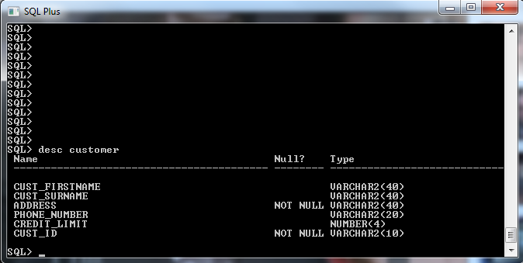
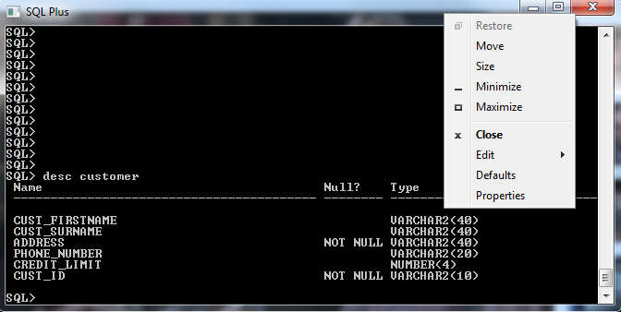
Using oracle
You will be given a user logon.
Can be accessed through desktop anywhere or lab machines
You should NOT put it on your own machines
Will run slow and take up all your processing power
Back up your own work using notepad files
DOS based interface
No easy menu
Right click on the top to see the menu options
Edit will allow you to cut and past

Slide 9
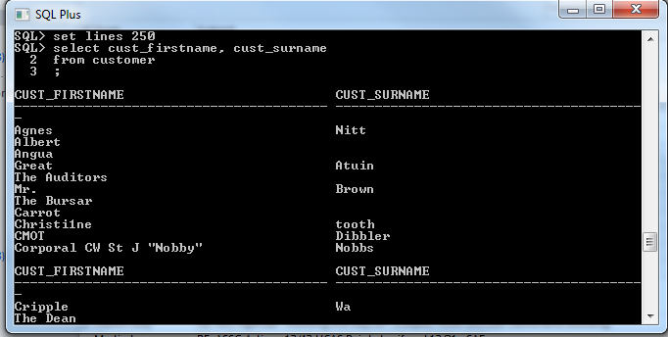
Running sql commands
Setting the lines will determine how many characters are displayed before a new line
SQL code selects the attributes and informs where they can be found
Consider that we want a list of customers in the database
The customer table contains multiple attributes the ones that we want are the 2 relating to name
Cust_firstname
Cust_surname
The display will show the attribute names as headings and then display the data
The headings are repeated every 10 lines unless they are set to be bigger pages, SET PAGES 100 will means that the heading are repeated every 100 records.

Slide 10
Filtering data
Database tables can be very large and hold millions of records we do not need to have all the data retrieved at once
The WHERE clause restricts the data set retrieved and filters the data
If we want to identify all the employees who have been blacklisted:
Employees are held in the consultant table
The attribute consultant_status holds records the status of the consultant
The attribute consultant_status needs to be restricted to ‘Blacklisted’
Select *
From consultant
Where consultant_status = ‘Blacklisted’
The query returns everything in the consultant table where the value of consultant_status is Blacklisted

Slide 11
Walkthrough example
Task is to find the contracts that have not yet been fulfilled
What table do you need to use
Which attributes do you need to look at
Do you have to filter the data?
What attribute gives you the data you need to filter on
SQL>Select contract_id
2 From contract
3 Where contract_end is null;
If a contract is ended/fulfilled then there will be an end date, no end date means no fulfillment
Using NULL means you can check for empty attribute slots, NULL is not the same as ‘’ or 0 it is an absence of data

Slide 12
notes
Read the question carefully!
Have you been asked to find ‘how many’ or ‘which’ there is a difference!
Use count(*) if you need to find how many
Select count(*)
From contract
Where contract_end is null
;
This will return a number. Select * will list the data
You can compare attributes with a value or another attribute
=
<
>
<=
=>
Is NULL
Is not NULL
<>

Slide 13
Seminar tasks
In your seminar you will be starting to use SQL
Your tutor will walk you through running the script and logging in
Save the code file to the u:\ in the root! Do not put it in a subdirectory
@u:\ffdb.sql
Do not run this more than once!
Keep the code you write!
Write it in note pad and then copy across
Make notes on what you did and what worked and didn’t and what you did to fix it
You will be expected to finish the code before the next seminar!

